Slide 1
Intro to Ohio Supercomputing Center (OSC) Resources
Cankun Wang
July 15, 2021

Slide 2
Outline
Why Unix, Linux as operating system?
High Performance Computing Basics
OSC cluster Pitzer
OSC On Demand environment
File access, download, upload, view
Create, submit, monitor jobs
Interactive apps – Rstudio

Slide 3
Why Linux?
easy access to the existing bioinformatics tools
automating repetitive tasks
access to other network machines
streamline data process and establish workflows
command line interface to communicate
looks cryptic but few commands take you a long way
3

Slide 4
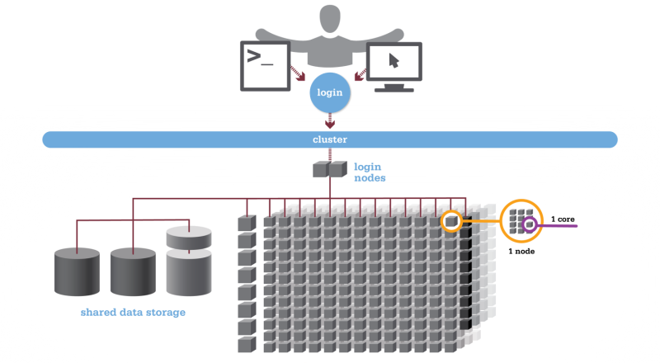
High Performance Computing (HPC)
Aggregated resources to perform computation intensive tasks
Core: processor (single unit)
Node: computer or a server
Cluster: multiple nodes connected
Workflow
connect to login node
submit job to scheduler
wait in queue
batch scheduler will run your job when resources become available
4

Slide 5
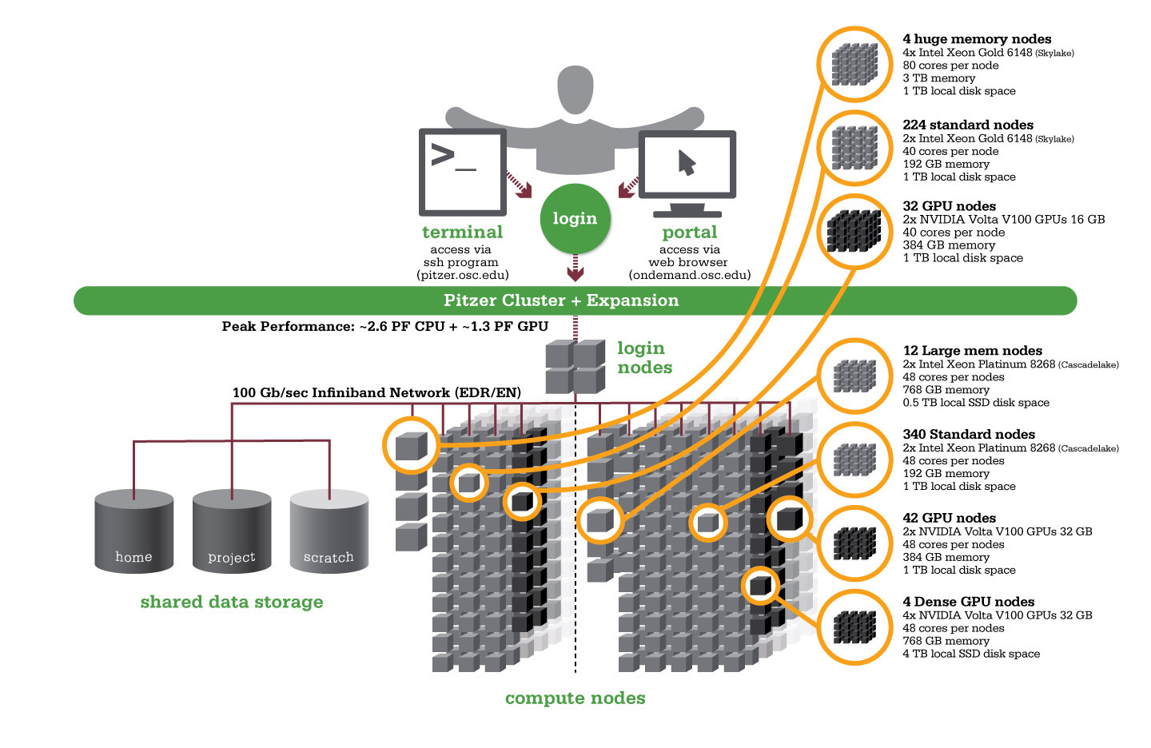

Ohio Supercomputer Center (OSC) Pitzer Cluster
A 10,240-core Dell Intel 19,104-core machine
Pitzer | Ohio Supercomputer Center (osc.edu)
5
Notes:
1 GPU node can replace as much as 32 CPUnodes
GPI nodes for more processing power, less need to focu on memory usage optimization
AI, Deep Learning , graphics, data science applications.

Slide 6
Terminology
Login nodes: limited CPU/memory usage, only for edit, download/upload files, manage your jobs for batch scheduling
Compute nodes: for CPU-memory intensive operations, available based on the requirements of the jobs submitted by all users
Scheduler: allows us to submit jobs that request the resources needed, in terms of nodes, CPUs memory and GPUs.
Jobs are queued and run when the requested resources become available
6

Slide 7
OSC On Demand
Access OSC HPC resources through a web browser
No need to install/ configure client software
Things you can do:
Upload/ download files
Create/edit/submit or monitor jobs
Run GUI applications
Connect via SSH – for command line access
7

Slide 8
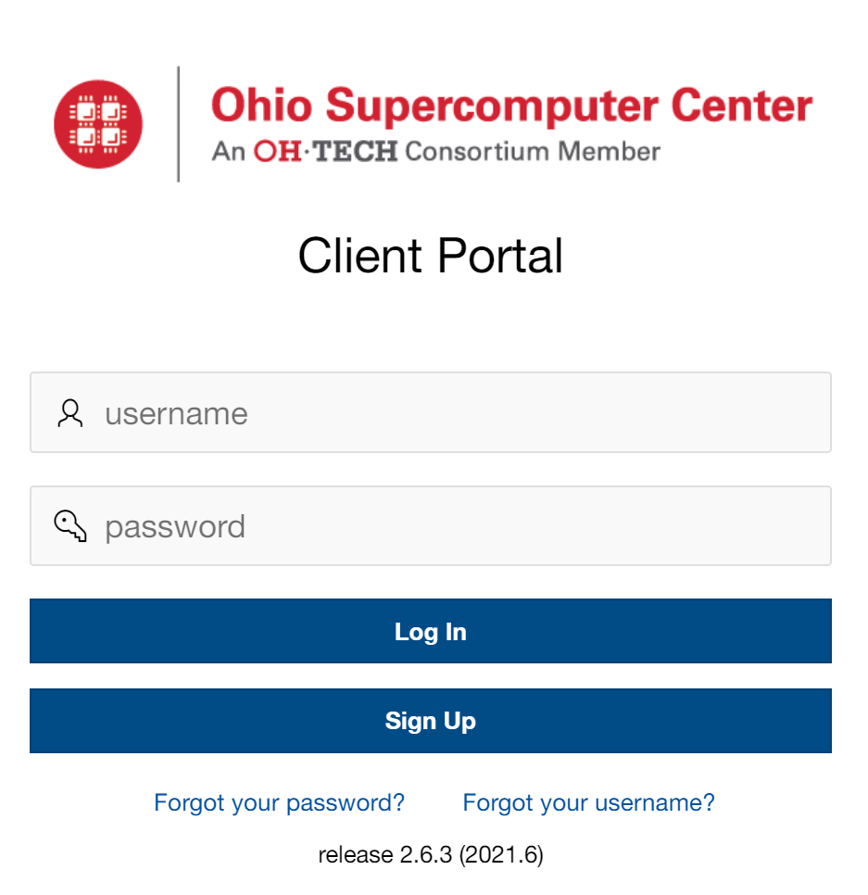
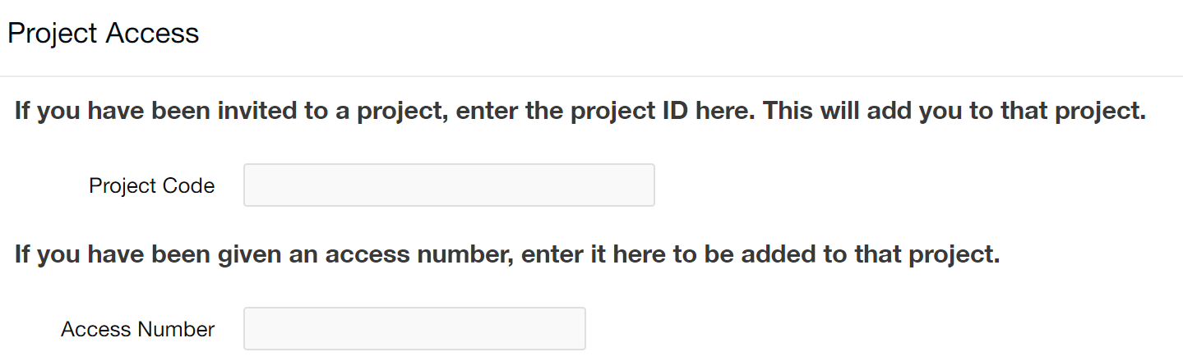
OSC – sign up
https://my.osc.edu/
Project code: XXX
8

Slide 9
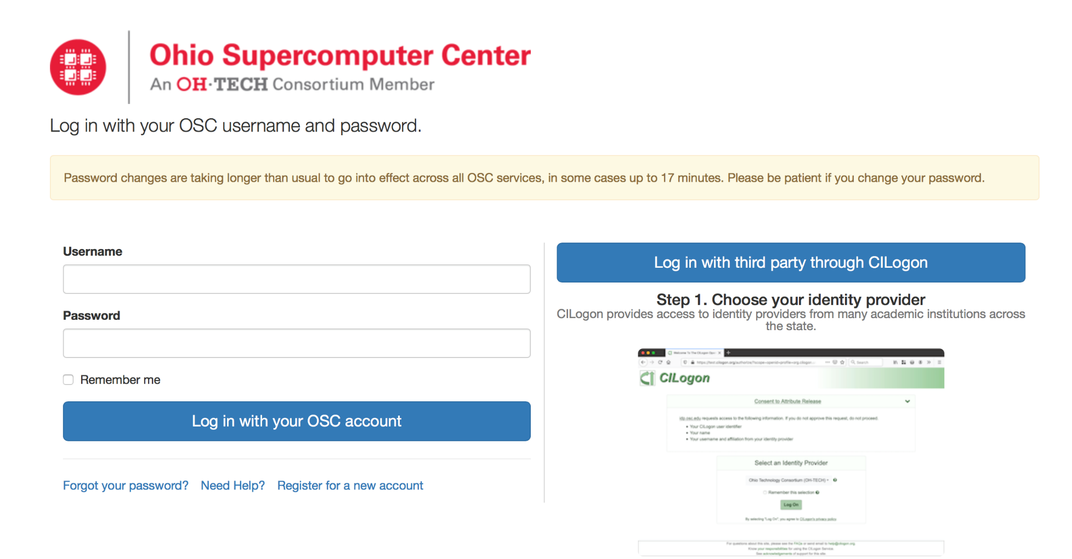
Login to OSC - OSC on Demand
https://ondemand.osc.edu
9

Slide 10
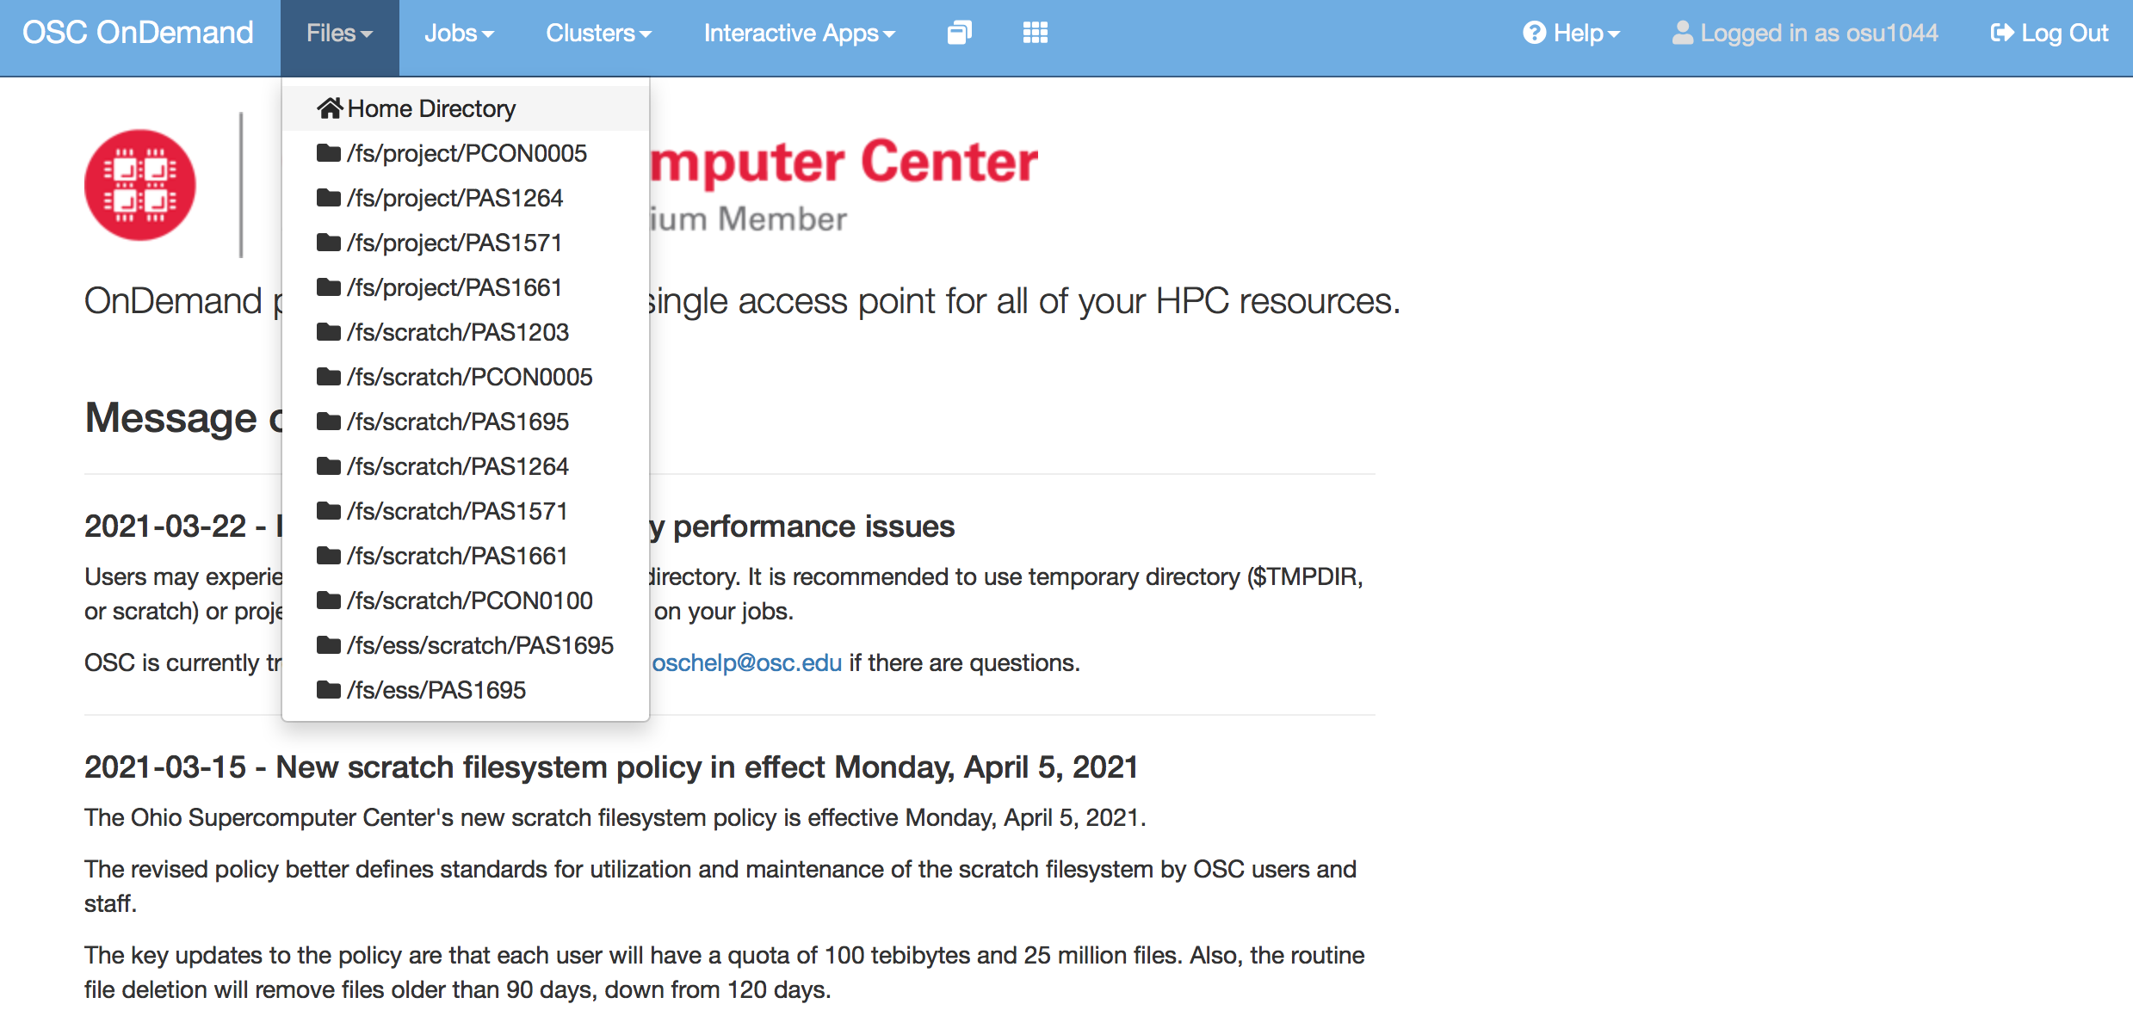
OSC File management
10

Slide 11
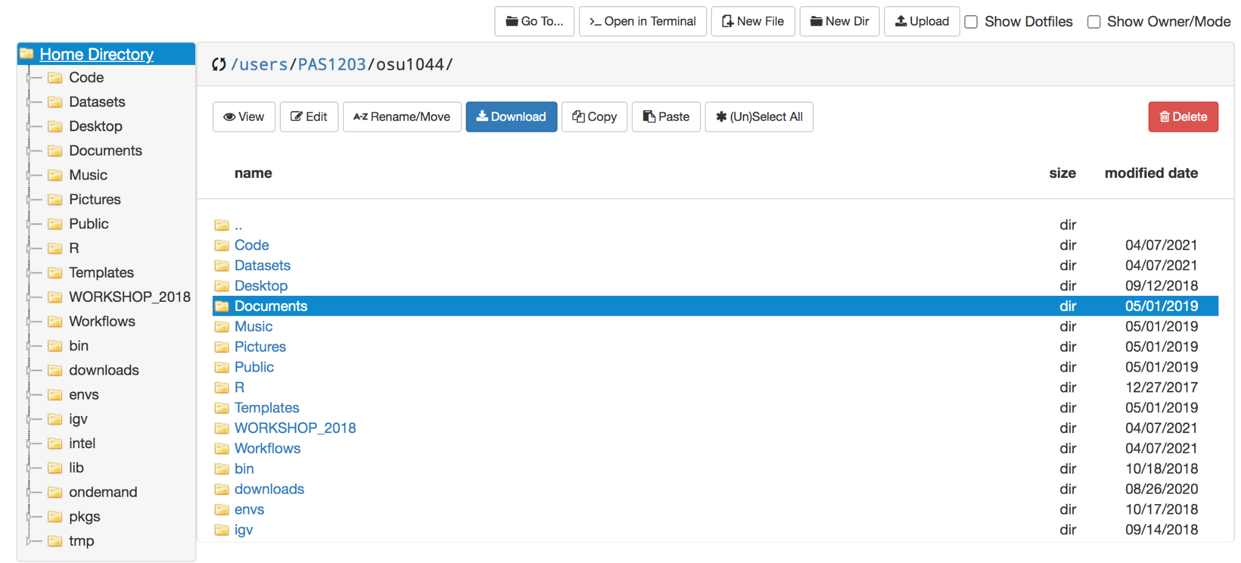
OSC File management – navigation
11

Slide 12
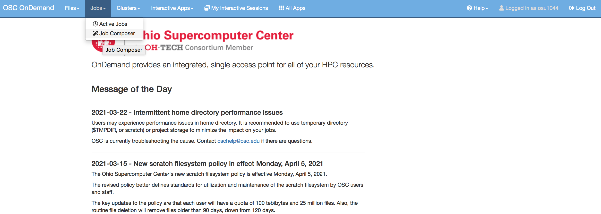
OSC Job management
12

Slide 13
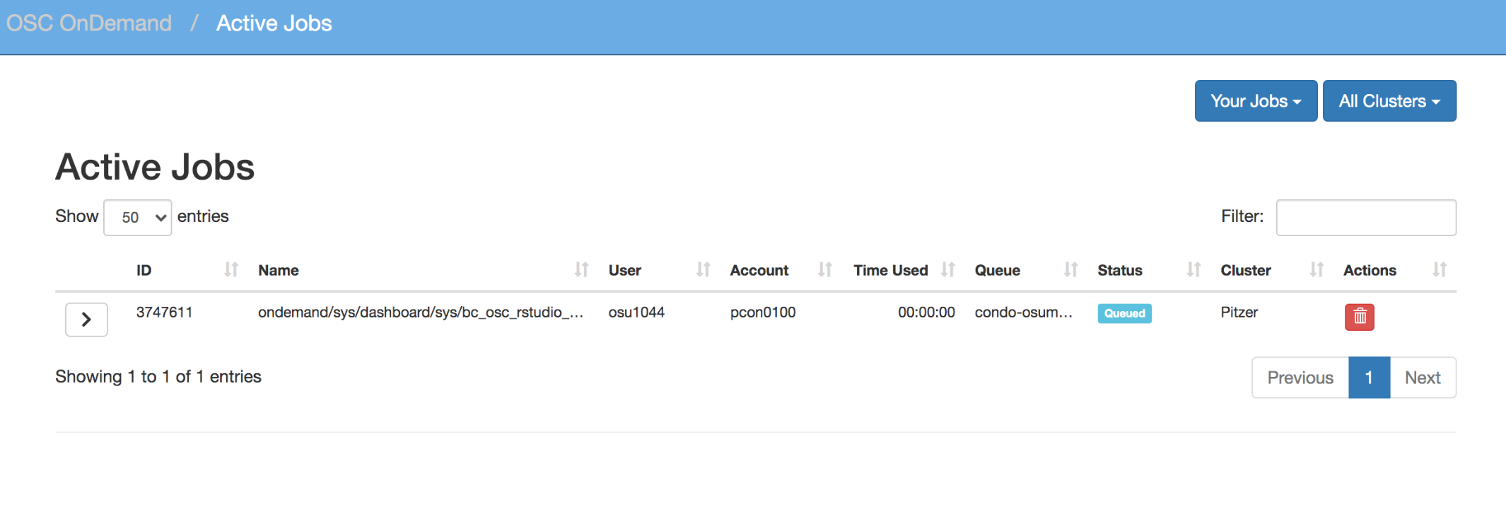
OSC Job management – Active jobs
13

Slide 14
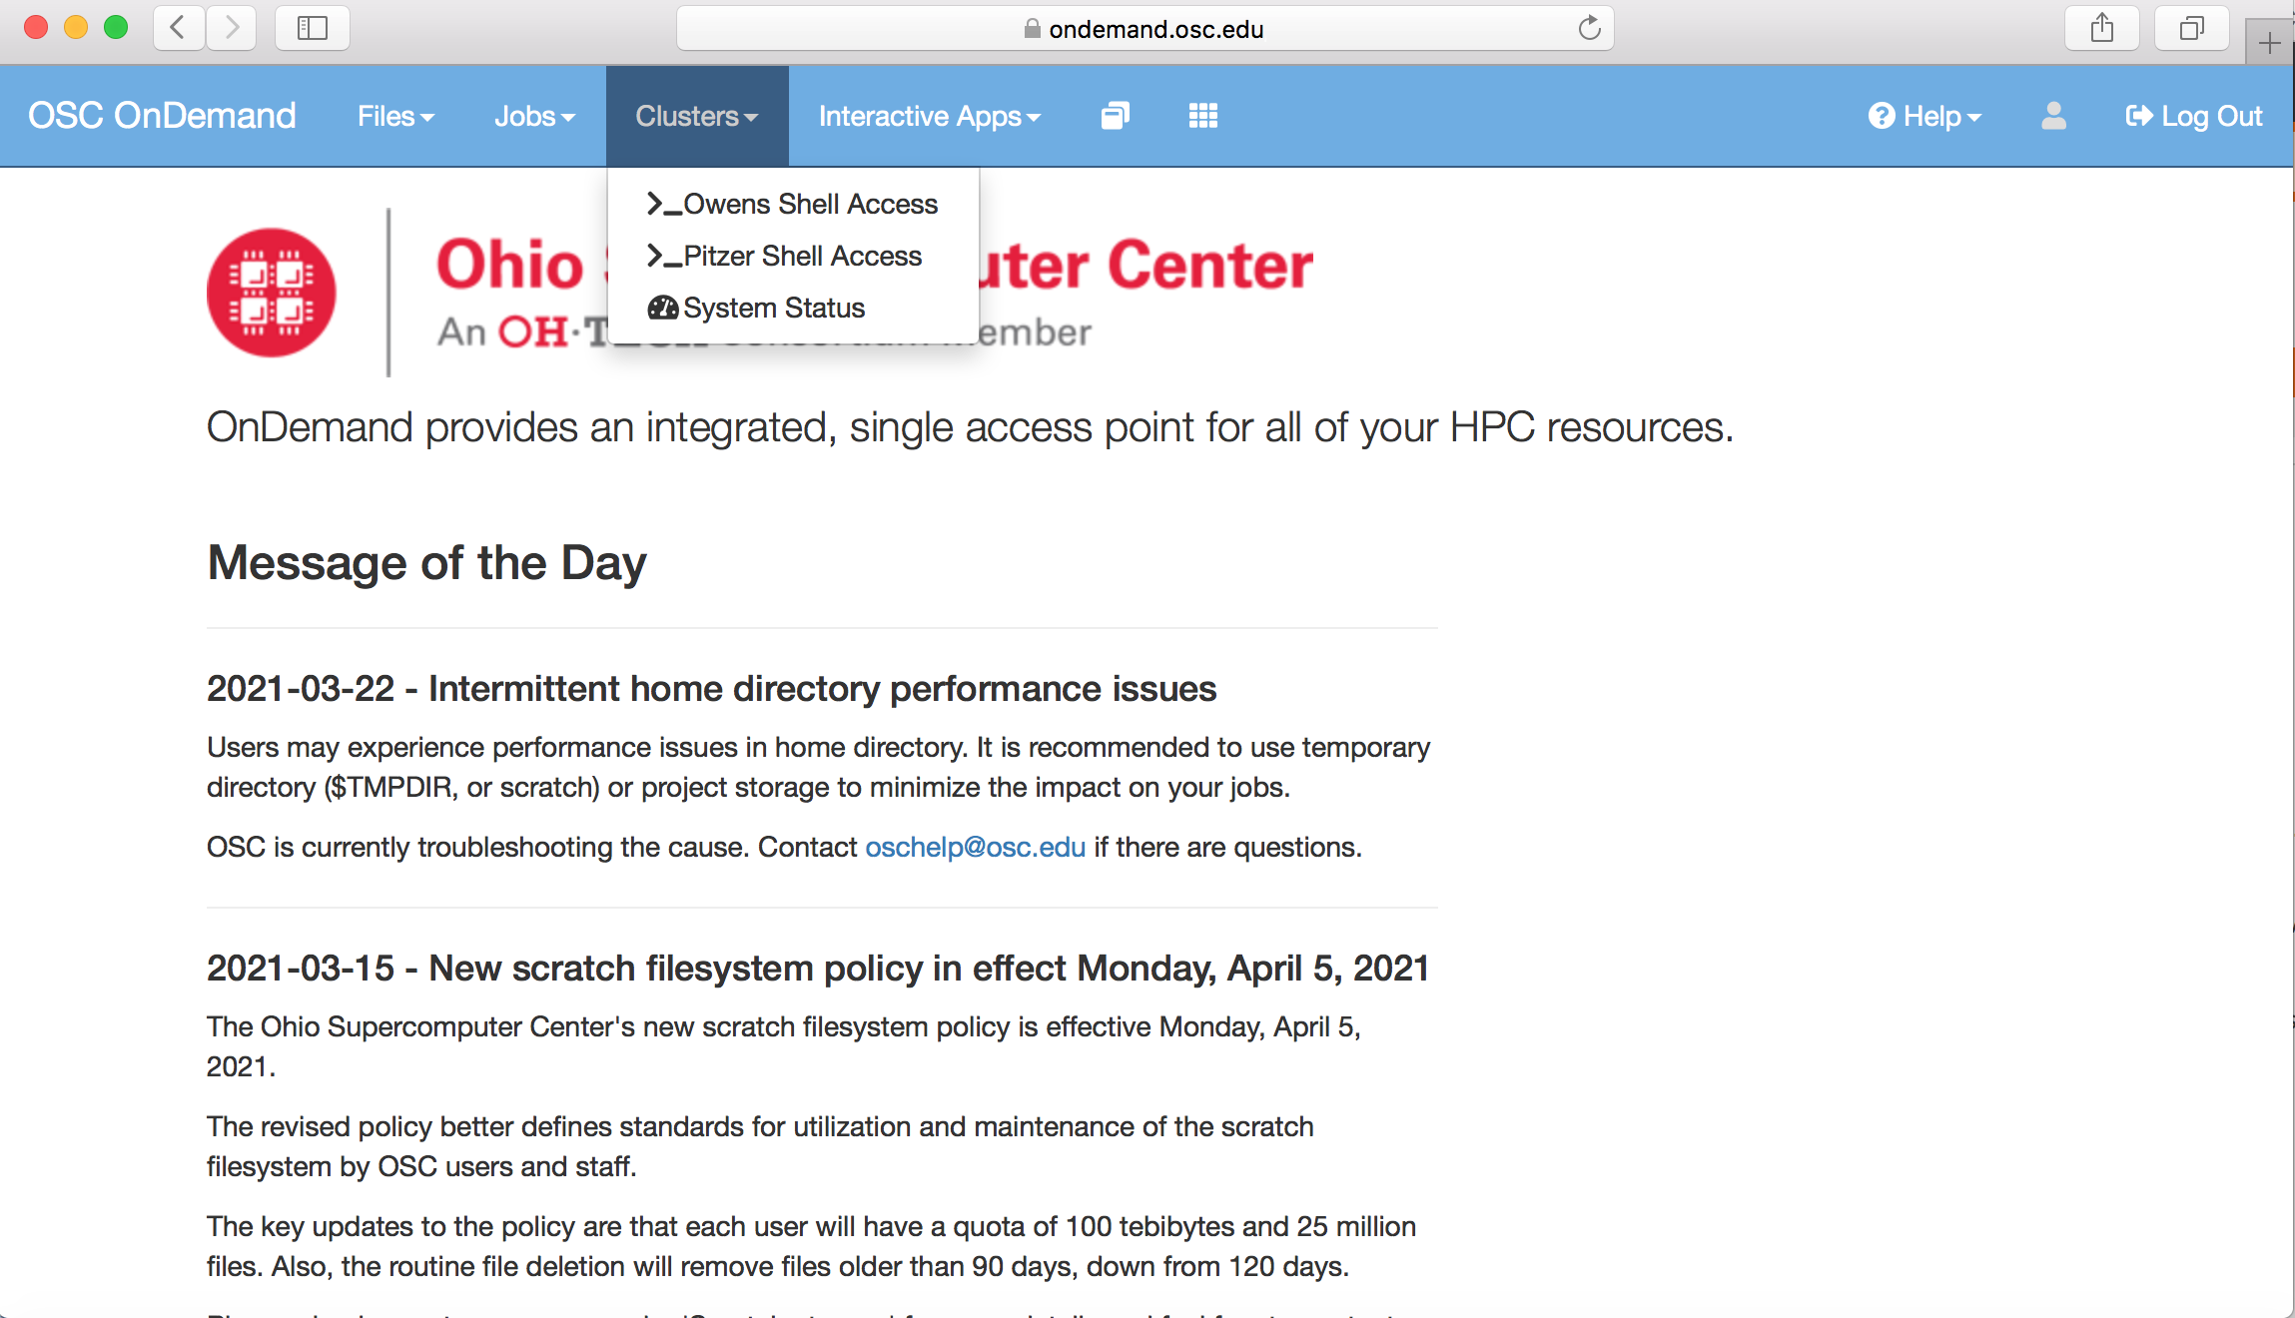
OSC OnDemand Shell Access
14

Slide 15
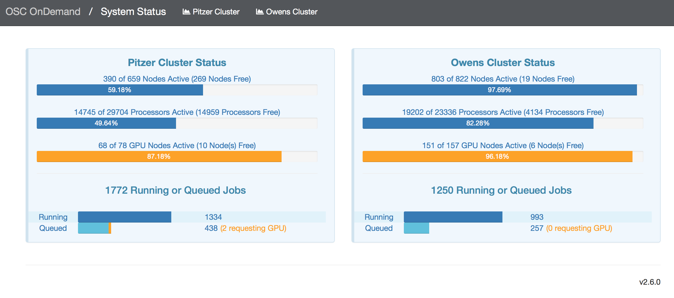
OSC OnDemand system status
Nodes/cores in use and number of running/queued jobs
Click on each cluster to get more detailed report like system load, CPU, memory usage, network load
15
Notes:
For eg, you can check the system status when your job has been waiting in the queue for a long time.

Slide 16
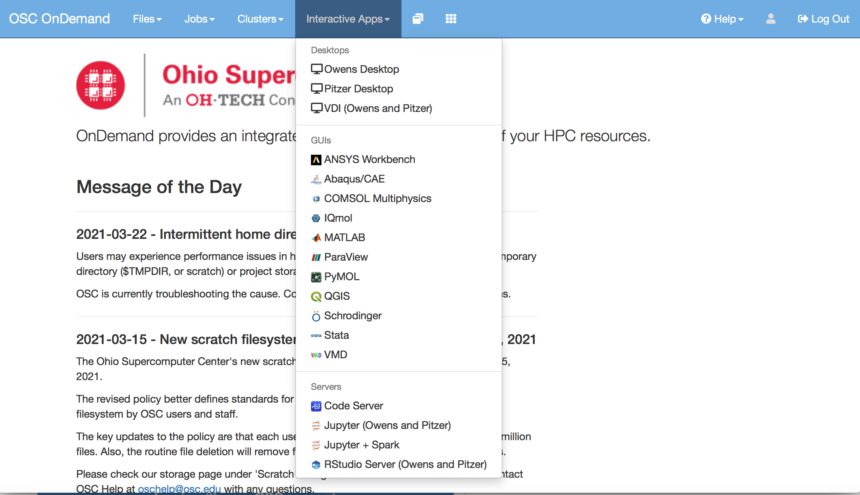
OSC On Demand- Interactive apps
16

Slide 17
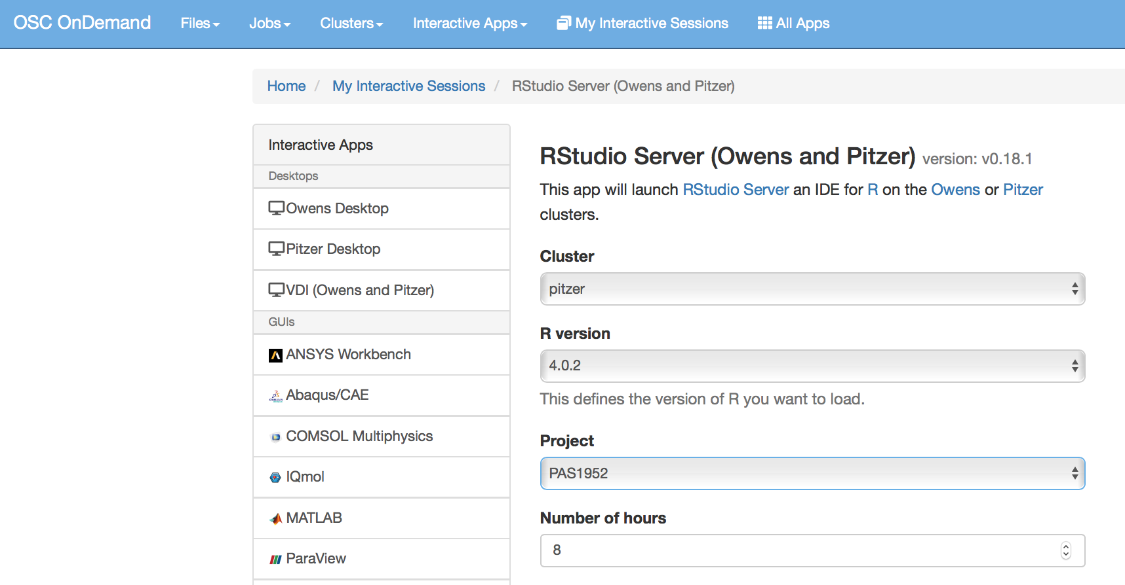
OSC OnDemand - Rstudio Server
Select cluster
Select latest R Version
Define Project ID
How long do you need resources?
17

Slide 18
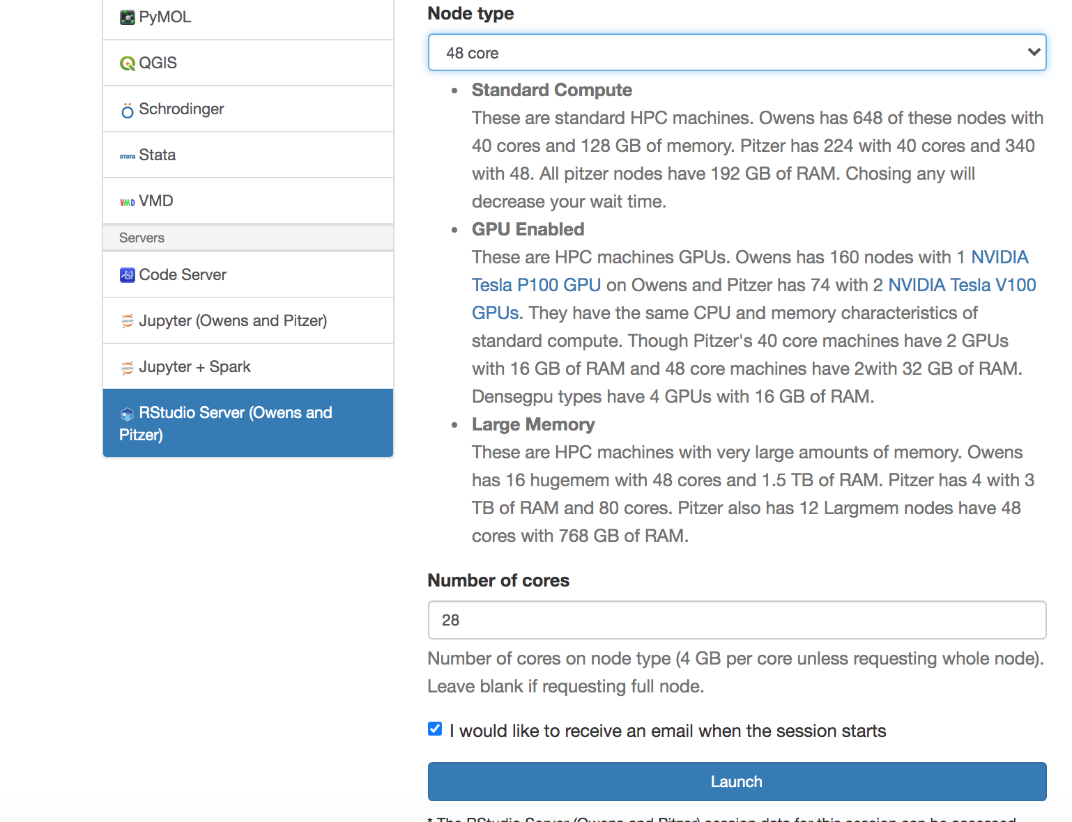
OSC OnDemand - Rstudio Server
1
Choose node type based on your need
Choose number of cores needed
18

Slide 19
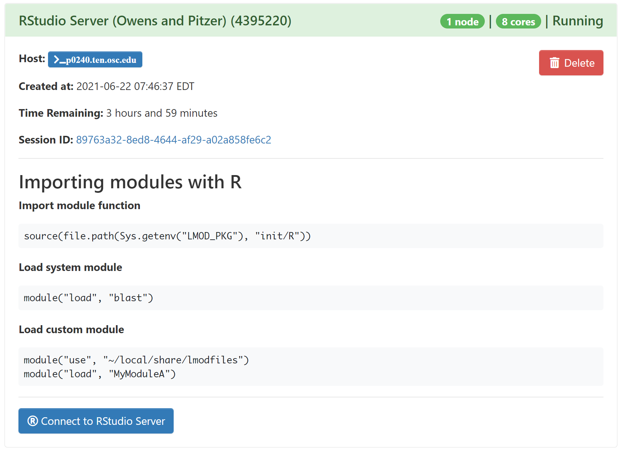
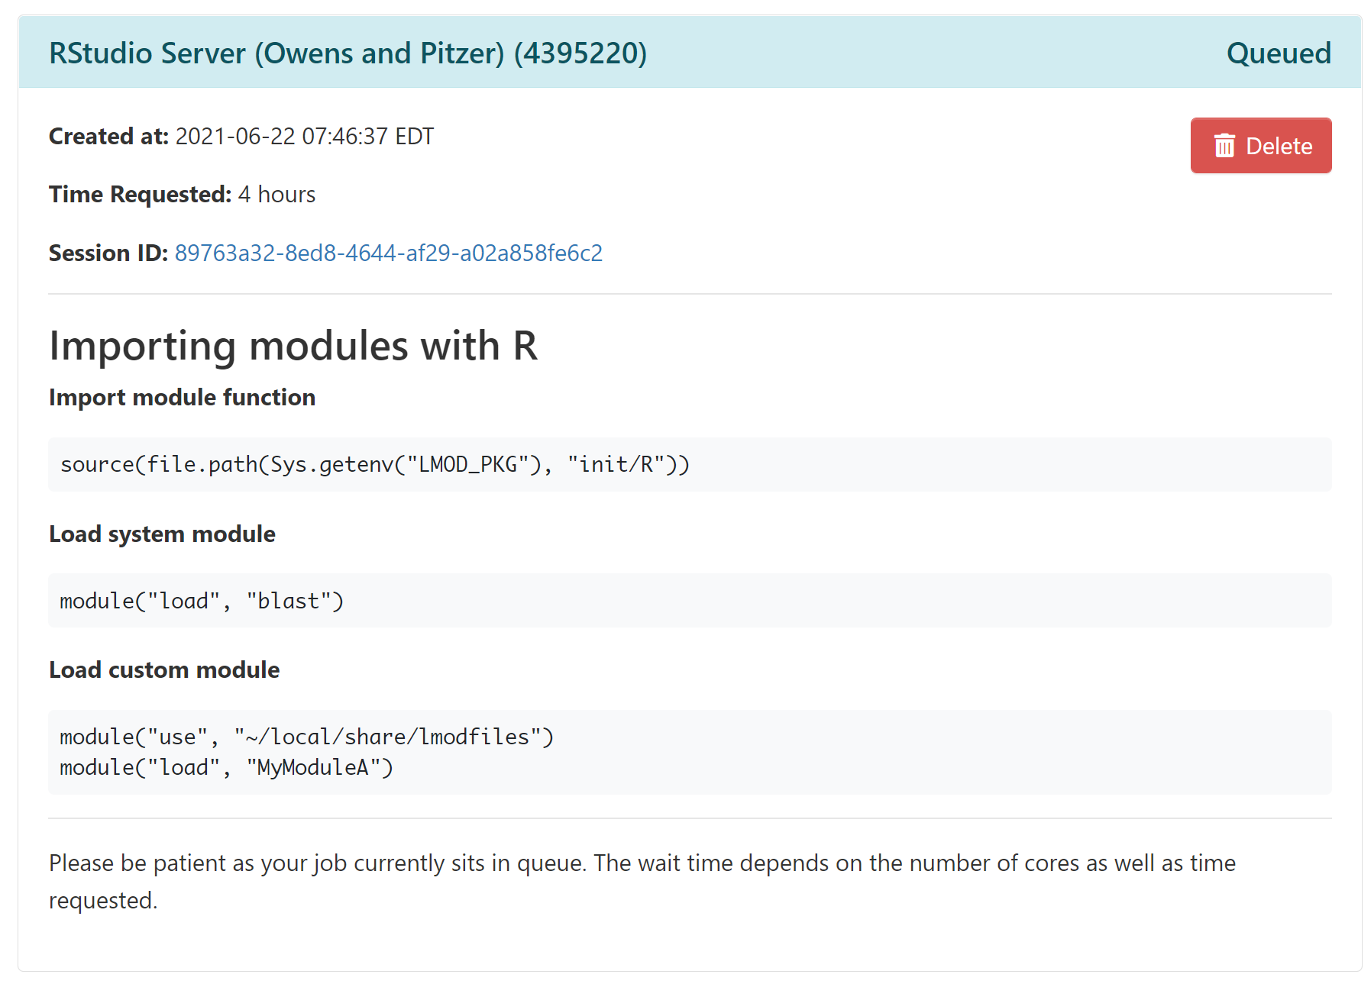
OSC OnDemand - Launching Rstudio Server
19

Slide 20
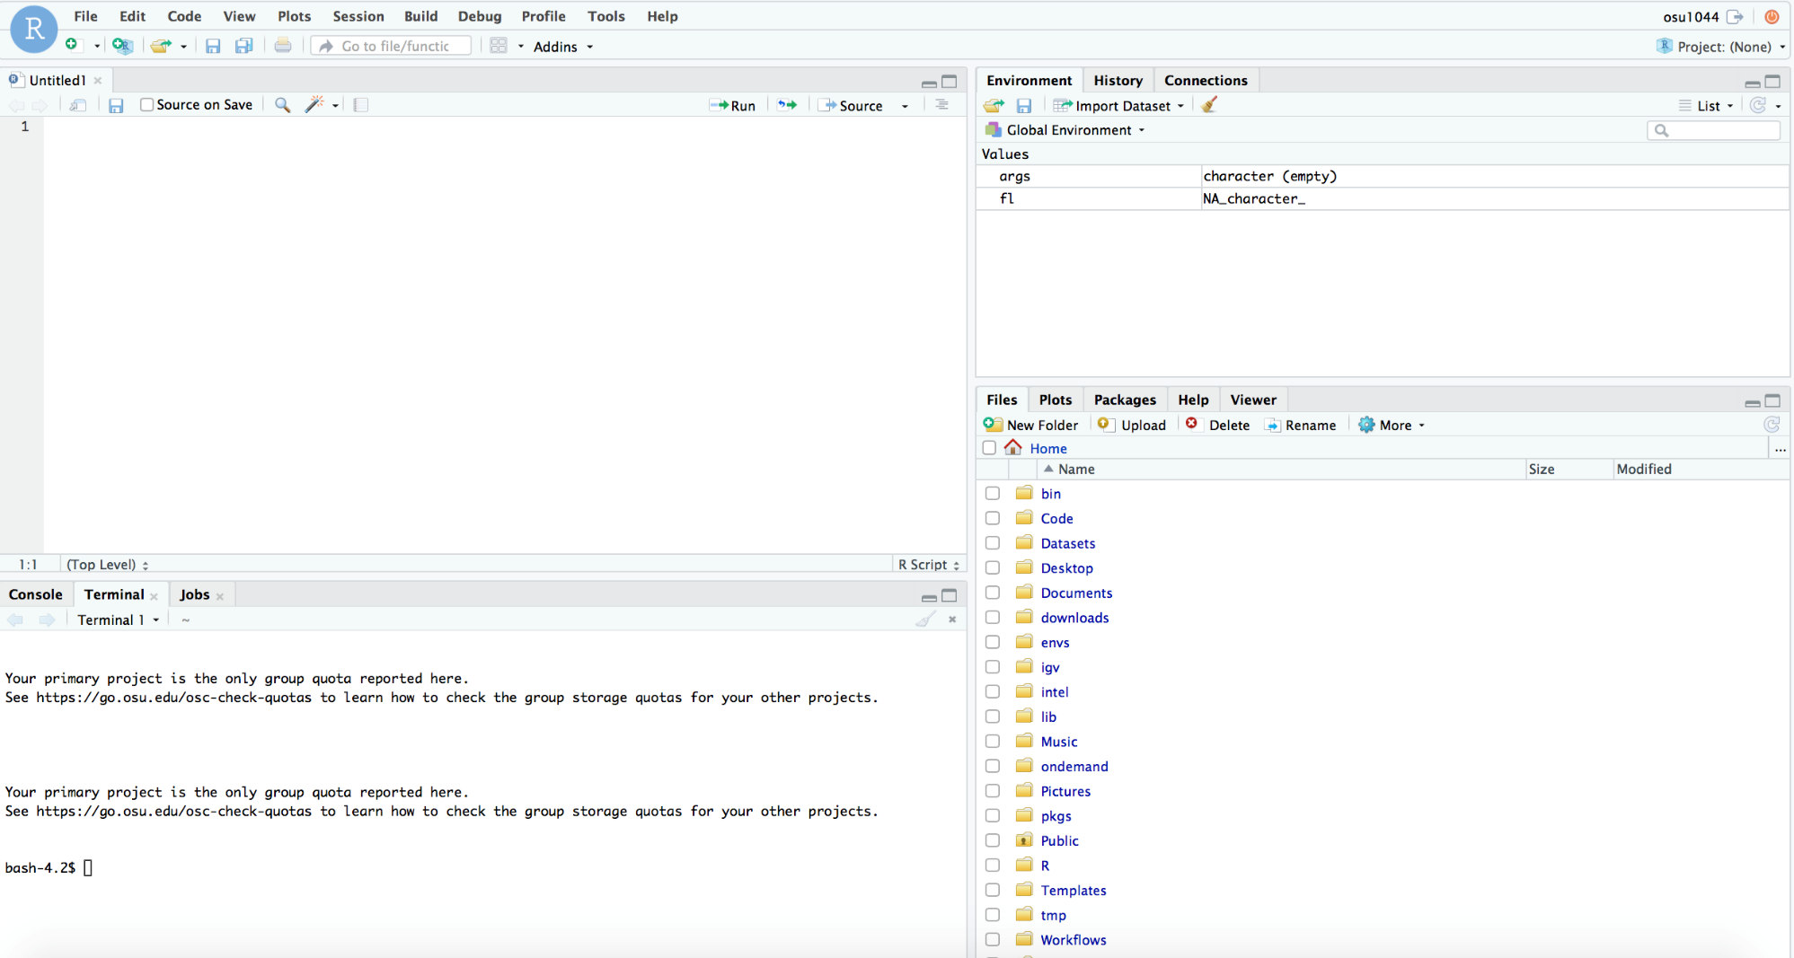
OSC OnDemand - Launching Rstudio Server
20
Notes:
The same as we used in our desktop

Slide 21
Useful resources on OSC website
Cluster Computing
https://www.osc.edu/services/cluster_computing
Pitzer
https://www.osc.edu/resources/technical_support/supercomputers/pitzer
OSC OnDemand
https://www.osc.edu/resources/online_portals/ondemand
Batch Processing on OSC
https://www.osc.edu/supercomputing/batch-processing-at-osc
21

Slide 22
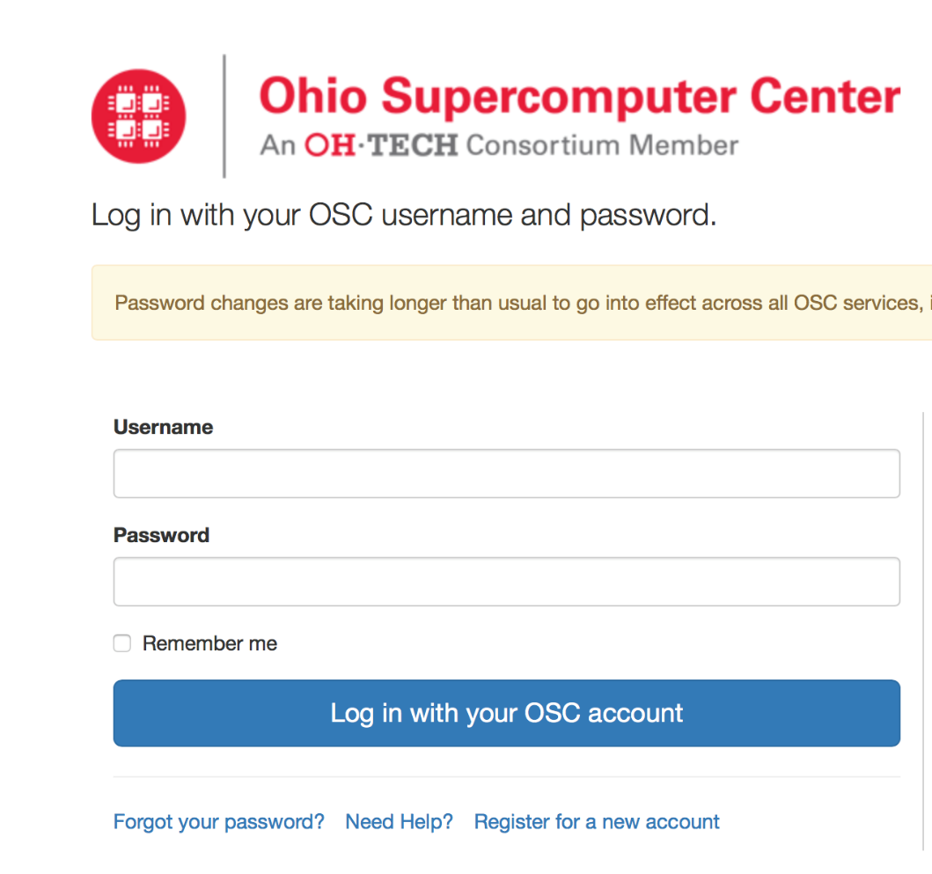
Login to OSC Classroom Project
https://class.osc.edu/
In OSC OnDemand, each user keeps a separate system environment
In OSC classroom, all students use pre-configured software packages & data
22

Slide 23
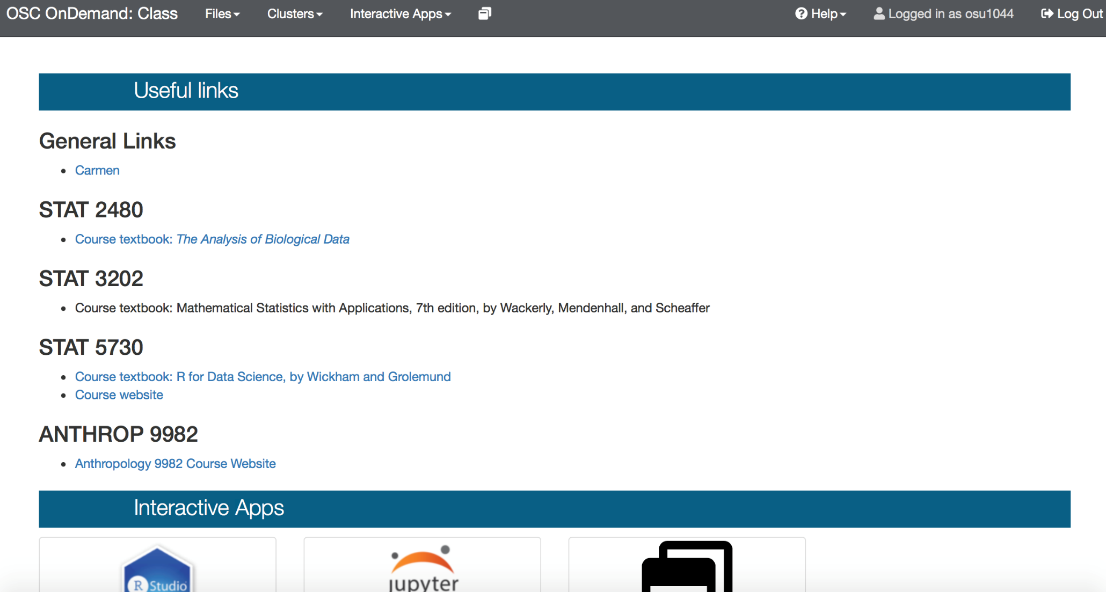
OSC classroom environment
23

